Slide 1
Data Leaks and the Role of SOC in Mitigating the Risk
Notes:
It generally falls under the Data Security and Data Loss Prevention (DLP) domains, rather than being its own standalone department. [1, 2, 3, 4]
Understanding how and where data leaks happen highlights how they are managed:
1. Data States (Where Leaks Occur)
Data at Rest: Leaks in this state usually happen through cloud misconfigurations, unsecured databases, or lost/stolen physical devices (like unencrypted laptops or USB drives).
Data in Transit: Leaks occur when data is being transferred. Without proper encryption, this includes unsecure emails, messaging apps, or exposed API calls.
Data in Use: Leaks occur when data is being actively processed and displayed on screens, printed on hard copies, or accidentally copied to unsecured clipboards. [1, 2, 3]

Slide 2
Objectives
- Know about DATA and its importance
- Know about data security and data risk
- SOC monitoring to detect data-leak

Slide 3
WHAT IS DATA?
Data [enterprise context] refers to the collection of raw facts, numbers, records, and digital information an organization generates/collects, prcesses and stores
CATEGORIES OF DATA
Transactional Data- Records Of Daily Business Events
Master Data- The core entities of a business that don’t change often
(employee lists, product catalogs, and vendor information)
Analytical Data- Historical information of a company used to spot trends and use in decision making or business intelligent
Unstructured Data- emails, internal documents (Memo), audio files, social media review

Slide 4


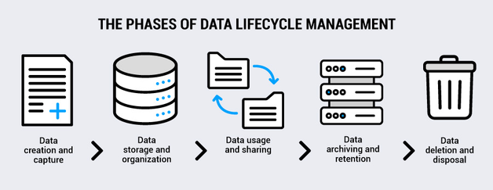

Slide 5
IMPORTANCE OF DATA TO AN ORGANISATION

Slide 6
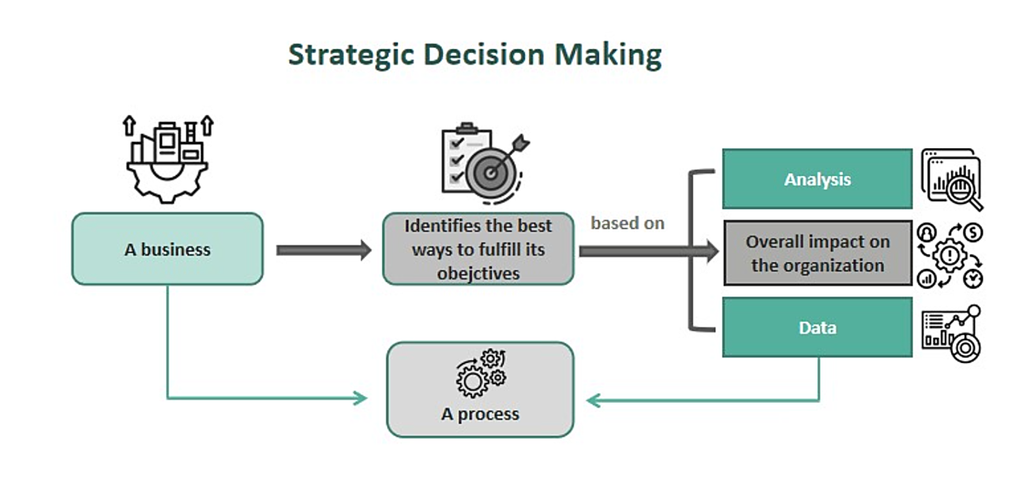
Impact: data-driven organizations are 5-6% more productive and 6% more profitable than competitors (mit sloan).

Slide 7
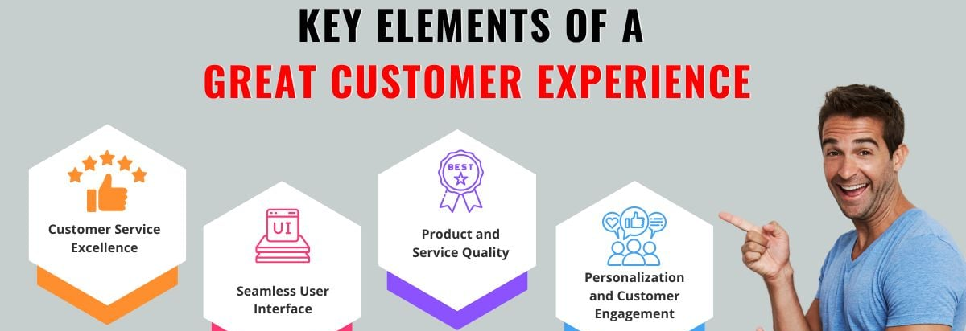

CUSTOMER UNDERSTANDING & PERSONALIZATION

Slide 8

OPERATIONAL EFFICIENCY & COST REDUCTION

Slide 9
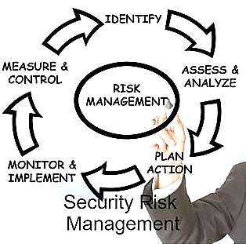
RISK MANAGEMENT & SECURITY

Slide 10
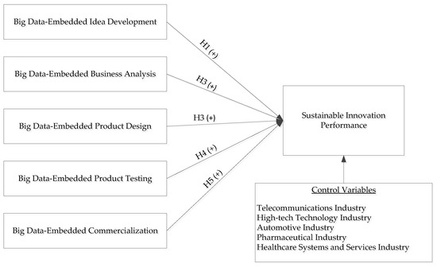
INNOVATION & PRODUCT DEVELOPMENT

Slide 11
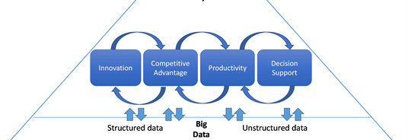
COMPETITIVE ADVANTAGE

Slide 12
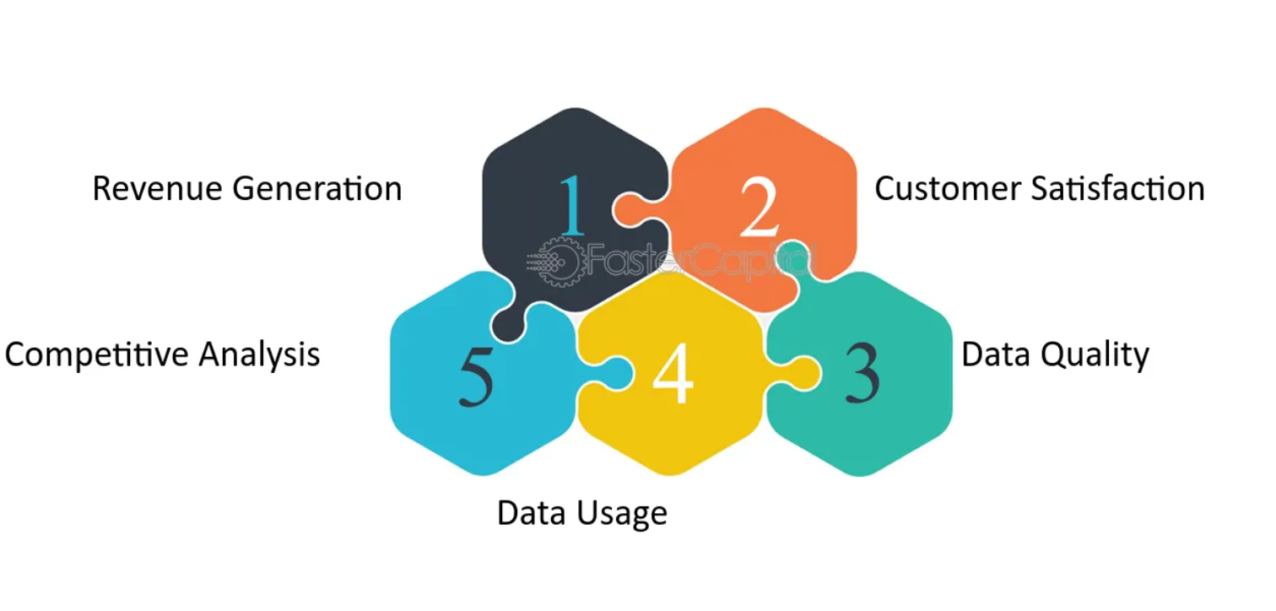
REVENUE GENERATION & MONETIZATION

Slide 13
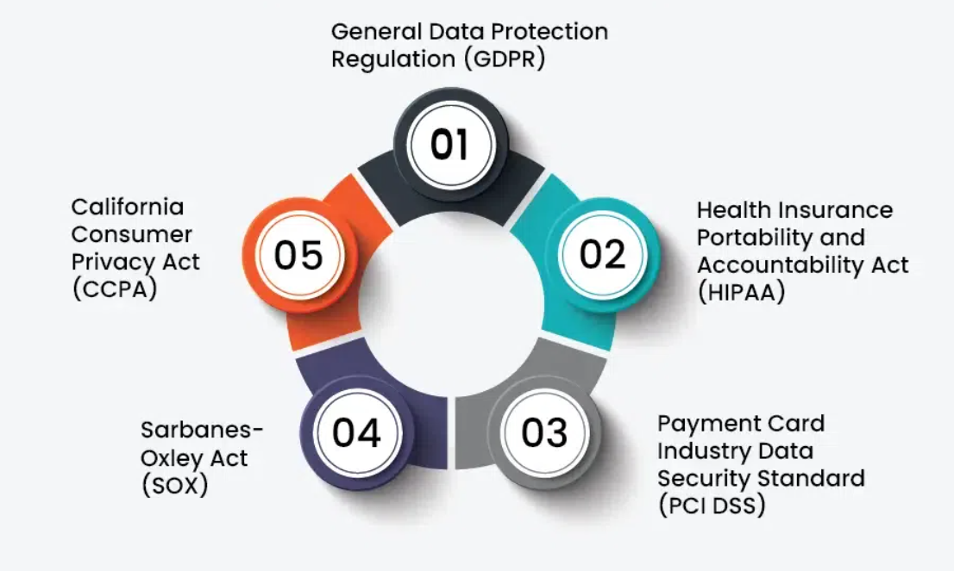
REGULATORY COMPLIANCE & LEGAL PROTECTION

Slide 14
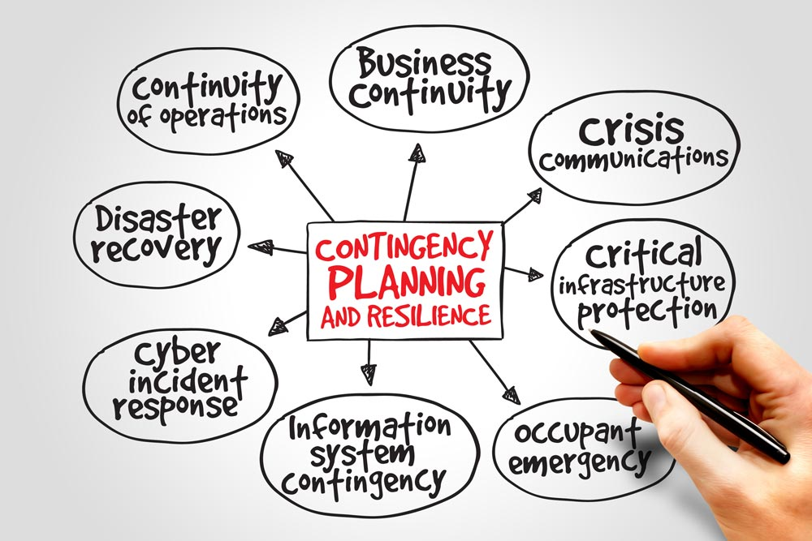
CRISIS RESPONSE & BUSINESS CONTINUITY

Slide 15
The Hidden Costs of Ignoring Data
Compliance fines | Missing audit trails → millions in penalties
Security breaches | No log monitoring → breach undetected for 6+ months
Losing to competitors | Data-driven rivals move 5x faster

Slide 16
SECURITY RISK RELATED WITH DATA
Unauthorized access (confidentiality)
Tampering (integrity)
Inaccessibility (availability)
Data leakage
Data theft
Data compliance violations — which could lead to financial loss, legal, and reputational damage

Slide 17
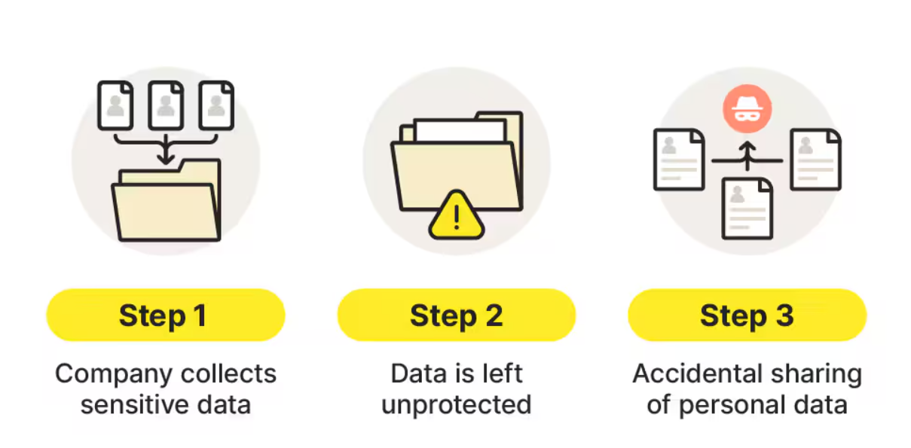
Data leaks

Slide 18
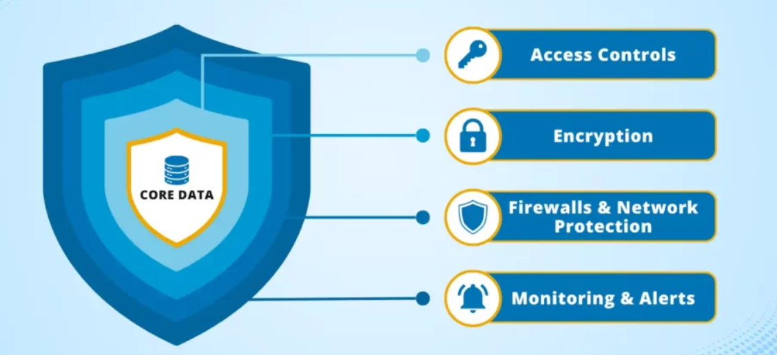
DATA PROTECTION(SECURITY)

Slide 19
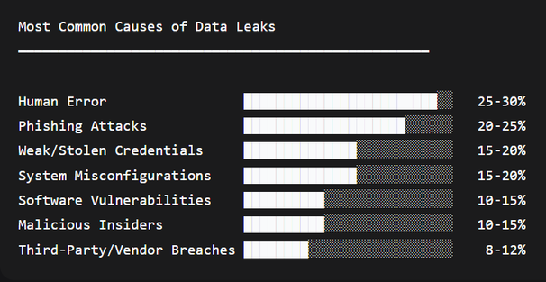
RESEARCH REVIEW On causes of DATA LEAKS
Notes:
The most common primary causes of data leaks include:
Human Error and Negligence: Accidental exposures, such as employees sending emails to the wrong recipient, leaving laptops in public spaces, or failing to follow proper security protocols.
Phishing and Social Engineering: Cybercriminals using deceptive emails or messages to trick users into handing over their login credentials or clicking on malicious links.
Weak or Stolen Credentials: Reusing passwords, using easily guessable passwords, or failing to implement Multi-Factor Authentication (MFA), giving attackers easy access.
Misconfigured Systems and Cloud Storage:
Improperly secured databases, cloud buckets (like Amazon S3), or developer environments left open to the public without adequate access controls.
Software Vulnerabilities and Unpatched Systems: Outdated software or unpatched firmware that contains known security flaws which automated bots or hackers can exploit.
Insider Threats: Current or former employees, contractors, or business partners who misuse their access privileges—either maliciously to steal and sell data, or accidentally through carelessness

Slide 20
The ROLE OF SOC IN MITIGATING DATA-LEAKS
Notes:
Here, I will be relating the role of the SOC with the identified data-leaks causes.

Slide 21
1. Detecting & Preventing Human Error
DLP (Data Loss Prevention) monitoring
-Alerts when sensitive data is emailed externally, uploaded to personal cloud drives, or copied to USB
User Entity Behavior Analytics (UEBA)
-Flags unusual activity (e.g., an employee downloading 10,000 records at 3 AM)
Email gateway inspection
- Blocks accidental sending of sensitive attachments to wrong recipients
Endpoint monitoring
- Detects when sensitive files are moved to public folders or unencrypted locations
Example rule: Alert if a user emails a file containing "PII," "SSN," or "confidential" outside the corporate domain
Notes:
The most common primary causes of data leaks include:
Human Error and Negligence: Accidental exposures, such as employees sending emails to the wrong recipient, leaving laptops in public spaces, or failing to follow proper security protocols.
Phishing and Social Engineering: Cybercriminals using deceptive emails or messages to trick users into handing over their login credentials or clicking on malicious links.
Weak or Stolen Credentials: Reusing passwords, using easily guessable passwords, or failing to implement Multi-Factor Authentication (MFA), giving attackers easy access.
Misconfigured Systems and Cloud Storage:
Improperly secured databases, cloud buckets (like Amazon S3), or developer environments left open to the public without adequate access controls.
Software Vulnerabilities and Unpatched Systems: Outdated software or unpatched firmware that contains known security flaws which automated bots or hackers can exploit.
Insider Threats: Current or former employees, contractors, or business partners who misuse their access privileges—either maliciously to steal and sell data, or accidentally through carelessness

Slide 22
2. Identifying System Misconfigurations
Cloud Security Posture Management (CSPM) - Scans for publicly exposed S3 buckets, Azure Blobs, or GCP buckets
Continuous configuration monitoring
- Detects changes like "bucket set to public" or "database open to 0.0.0.0/0"
Vulnerability scanning
- Identifies default credentials still in use
Security misconfiguration playbooks
- SOC initiates automated remediation (e.g., closing an open port)
Example: SOC tool alerts: *"S3 bucket 'customer-backup' has public read access."* SOC triages, confirms, and initiates fix.
Notes:
The most common primary causes of data leaks include:
Human Error and Negligence: Accidental exposures, such as employees sending emails to the wrong recipient, leaving laptops in public spaces, or failing to follow proper security protocols.
Phishing and Social Engineering: Cybercriminals using deceptive emails or messages to trick users into handing over their login credentials or clicking on malicious links.
Weak or Stolen Credentials: Reusing passwords, using easily guessable passwords, or failing to implement Multi-Factor Authentication (MFA), giving attackers easy access.
Misconfigured Systems and Cloud Storage:
Improperly secured databases, cloud buckets (like Amazon S3), or developer environments left open to the public without adequate access controls.
Software Vulnerabilities and Unpatched Systems: Outdated software or unpatched firmware that contains known security flaws which automated bots or hackers can exploit.
Insider Threats: Current or former employees, contractors, or business partners who misuse their access privileges—either maliciously to steal and sell data, or accidentally through carelessness

Slide 23
3. Responding to Phishing Attacks
Phishing detection & response
- Rapidly identifies compromised credentials from phishing
Email security monitoring
- Blocks malicious links and attachments before they reach users
Credential theft hunting - Checks for logins from unusual locations or devices
Automated account isolation
- Temporarily disables an account suspected of being phished
SIEM correlation
- Alerts when a user clicks a phishing link and then accesses sensitive data
Example: SOC sees: User clicked malicious link → 2 minutes later, login from Russia → 1 minute later, downloading HR database. SOC immediately disables account and resets credentials
Notes:
The most common primary causes of data leaks include:
Human Error and Negligence: Accidental exposures, such as employees sending emails to the wrong recipient, leaving laptops in public spaces, or failing to follow proper security protocols.
Phishing and Social Engineering: Cybercriminals using deceptive emails or messages to trick users into handing over their login credentials or clicking on malicious links.
Weak or Stolen Credentials: Reusing passwords, using easily guessable passwords, or failing to implement Multi-Factor Authentication (MFA), giving attackers easy access.
Misconfigured Systems and Cloud Storage:
Improperly secured databases, cloud buckets (like Amazon S3), or developer environments left open to the public without adequate access controls.
Software Vulnerabilities and Unpatched Systems: Outdated software or unpatched firmware that contains known security flaws which automated bots or hackers can exploit.
Insider Threats: Current or former employees, contractors, or business partners who misuse their access privileges—either maliciously to steal and sell data, or accidentally through carelessness

Slide 24
4. Detecting Malicious Insiders
Insider threat detection rules
- Flags volume anomalies (e.g., exporting entire database)
Data staging detection
-Identifies users moving data to personal drives before leaving
Privilege abuse monitoring
- Alerts when admins query sensitive tables without justification
User-to-user unusual sharing - Detects data being sent to personal email addresses
Example: SOC alerts on: Employee with 2 weeks notice → copying 5GB of engineering docs to USB → uploading to personal Dropbox.
Notes:
The most common primary causes of data leaks include:
Human Error and Negligence: Accidental exposures, such as employees sending emails to the wrong recipient, leaving laptops in public spaces, or failing to follow proper security protocols.
Phishing and Social Engineering: Cybercriminals using deceptive emails or messages to trick users into handing over their login credentials or clicking on malicious links.
Weak or Stolen Credentials: Reusing passwords, using easily guessable passwords, or failing to implement Multi-Factor Authentication (MFA), giving attackers easy access.
Misconfigured Systems and Cloud Storage:
Improperly secured databases, cloud buckets (like Amazon S3), or developer environments left open to the public without adequate access controls.
Software Vulnerabilities and Unpatched Systems: Outdated software or unpatched firmware that contains known security flaws which automated bots or hackers can exploit.
Insider Threats: Current or former employees, contractors, or business partners who misuse their access privileges—either maliciously to steal and sell data, or accidentally through carelessness

Slide 25
5. Preventing Weak/Stolen Credential Abuse
Brute force detection - Blocks repeated failed login attempts
Credential stuffing detection
- Identifies login attempts using passwords from previous breaches
Anomalous login detection
- Flags impossible travel (e.g., login from Lagos and London within 1 hour)
MFA bypass monitoring
- Detects when MFA is disabled or SMS codes are intercepted
Honeytoken deployment
- SOC plants fake credentials; any use triggers an alert
Example: SOC sees: Admin account used from new device at 2 AM → accessing customer database → unusual data export. SOC blocks session and rotates credentials.
Notes:
The most common primary causes of data leaks include:
Human Error and Negligence: Accidental exposures, such as employees sending emails to the wrong recipient, leaving laptops in public spaces, or failing to follow proper security protocols.
Phishing and Social Engineering: Cybercriminals using deceptive emails or messages to trick users into handing over their login credentials or clicking on malicious links.
Weak or Stolen Credentials: Reusing passwords, using easily guessable passwords, or failing to implement Multi-Factor Authentication (MFA), giving attackers easy access.
Misconfigured Systems and Cloud Storage:
Improperly secured databases, cloud buckets (like Amazon S3), or developer environments left open to the public without adequate access controls.
Software Vulnerabilities and Unpatched Systems: Outdated software or unpatched firmware that contains known security flaws which automated bots or hackers can exploit.
Insider Threats: Current or former employees, contractors, or business partners who misuse their access privileges—either maliciously to steal and sell data, or accidentally through carelessness

Slide 26
6. Detecting Software Vulnerability Exploitation
Threat intelligence integration
- SOC receives CVE alerts (e.g., Log4Shell) and scans for vulnerable assets
Exploit detection
- Looks for exploit attempts in logs (e.g., SQL injection patterns, remote code execution)
Patch compliance monitoring
- SOC verifies critical patches are applied within SLA
Honeypots
- Decoy infrastructures/databases that alert SOC when touched
Notes:
The most common primary causes of data leaks include:
Human Error and Negligence: Accidental exposures, such as employees sending emails to the wrong recipient, leaving laptops in public spaces, or failing to follow proper security protocols.
Phishing and Social Engineering: Cybercriminals using deceptive emails or messages to trick users into handing over their login credentials or clicking on malicious links.
Weak or Stolen Credentials: Reusing passwords, using easily guessable passwords, or failing to implement Multi-Factor Authentication (MFA), giving attackers easy access.
Misconfigured Systems and Cloud Storage:
Improperly secured databases, cloud buckets (like Amazon S3), or developer environments left open to the public without adequate access controls.
Software Vulnerabilities and Unpatched Systems: Outdated software or unpatched firmware that contains known security flaws which automated bots or hackers can exploit.
Insider Threats: Current or former employees, contractors, or business partners who misuse their access privileges—either maliciously to steal and sell data, or accidentally through carelessness

Slide 27
7. Monitoring Third-Party/Vendor Risks
Third-party API monitoring
- Detects excessive or unusual API calls from vendors
Vendor access reviews - Flags stale vendor accounts still active
Data transfer tracking
- Monitors what data vendors are pulling from your systems
Threat intel on vendors
- Subscribes to breach reports involving your vendors
Example: SOC intel alert: "Vendor X had a breach." SOC immediately rotates all keys and revokes vendor access pending review.
Notes:
The most common primary causes of data leaks include:
Human Error and Negligence: Accidental exposures, such as employees sending emails to the wrong recipient, leaving laptops in public spaces, or failing to follow proper security protocols.
Phishing and Social Engineering: Cybercriminals using deceptive emails or messages to trick users into handing over their login credentials or clicking on malicious links.
Weak or Stolen Credentials: Reusing passwords, using easily guessable passwords, or failing to implement Multi-Factor Authentication (MFA), giving attackers easy access.
Misconfigured Systems and Cloud Storage:
Improperly secured databases, cloud buckets (like Amazon S3), or developer environments left open to the public without adequate access controls.
Software Vulnerabilities and Unpatched Systems: Outdated software or unpatched firmware that contains known security flaws which automated bots or hackers can exploit.
Insider Threats: Current or former employees, contractors, or business partners who misuse their access privileges—either maliciously to steal and sell data, or accidentally through carelessness

Slide 28
WHAT To do in the incident of data leak
Detection ↓ Triage ↓ Containment ↓ Investigation & Forensics ↓ Eradication ↓ Recovery ↓ Communication & Reporting ↓ Lessons Learned
Notes:
The most common primary causes of data leaks include:
Human Error and Negligence: Accidental exposures, such as employees sending emails to the wrong recipient, leaving laptops in public spaces, or failing to follow proper security protocols.
Phishing and Social Engineering: Cybercriminals using deceptive emails or messages to trick users into handing over their login credentials or clicking on malicious links.
Weak or Stolen Credentials: Reusing passwords, using easily guessable passwords, or failing to implement Multi-Factor Authentication (MFA), giving attackers easy access.
Misconfigured Systems and Cloud Storage:
Improperly secured databases, cloud buckets (like Amazon S3), or developer environments left open to the public without adequate access controls.
Software Vulnerabilities and Unpatched Systems: Outdated software or unpatched firmware that contains known security flaws which automated bots or hackers can exploit.
Insider Threats: Current or former employees, contractors, or business partners who misuse their access privileges—either maliciously to steal and sell data, or accidentally through carelessness

